Slide 1
PCB LAB Workshop 1: General + Schematic
Azra Rangwala
Ilona Lameka
Ridwan Hussain
Casey ye

Slide 2
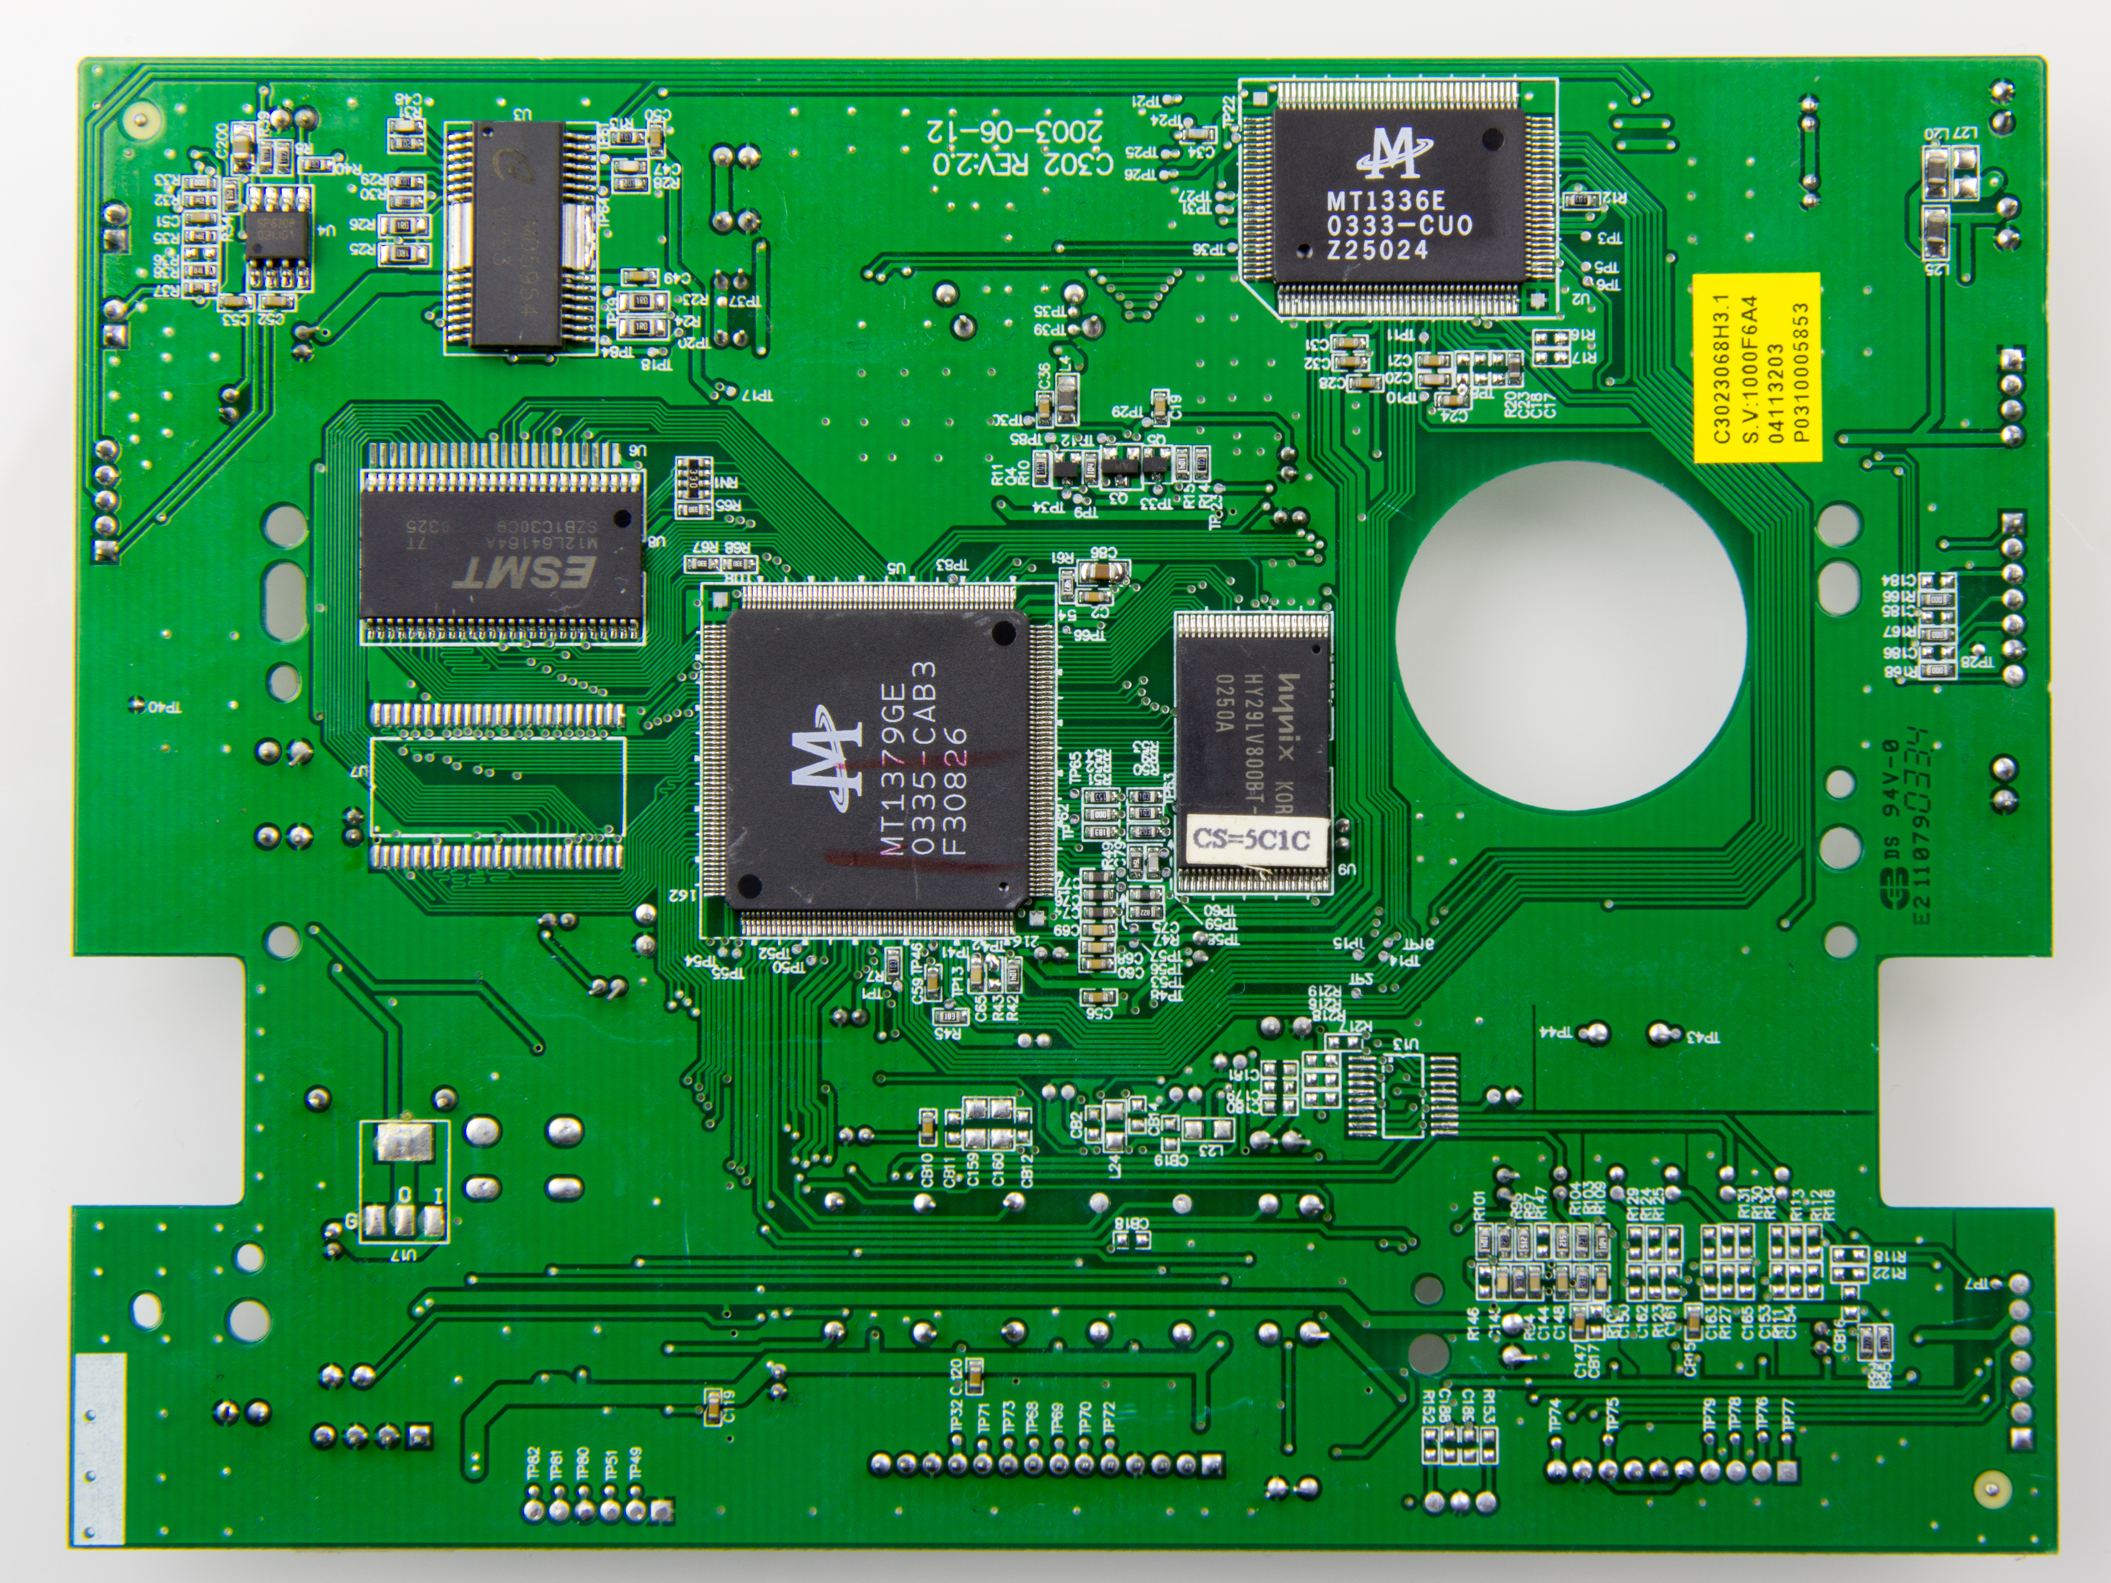
What is a PCB?
These ICs are SMT
Component labels
Mounting holes
PCB (Printed Circuit Board) : thin electronic assembly that uses copper conductors to create electrical connections between components
YouTube Link With More Visuals
Traces = connections
Copper pads: where we solder surface mount (SMT) components

Slide 3
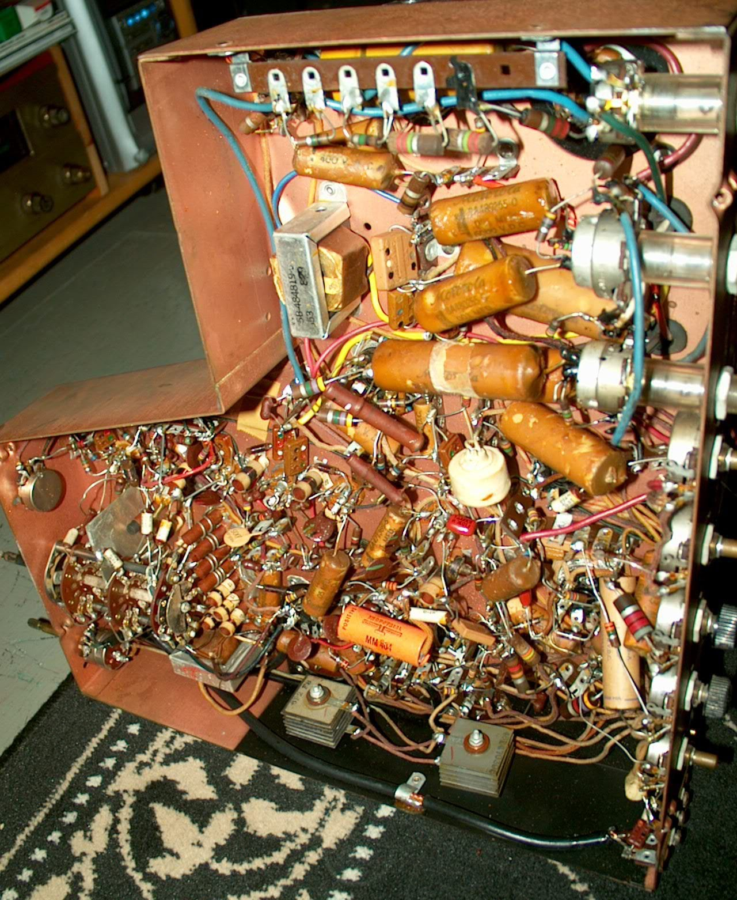
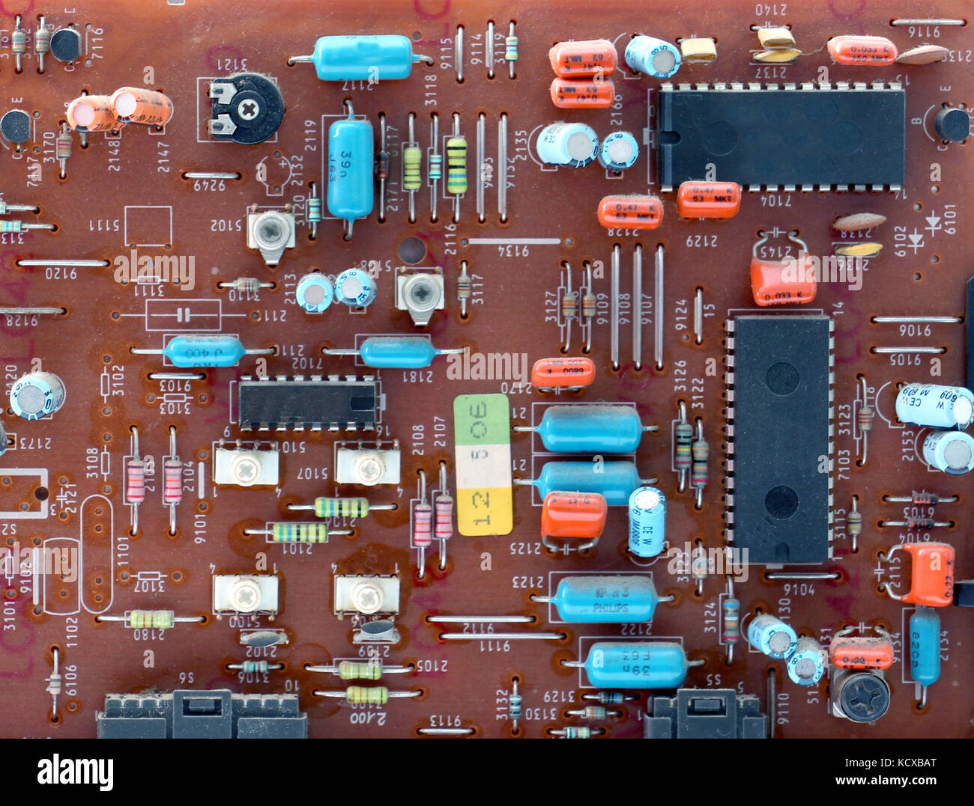
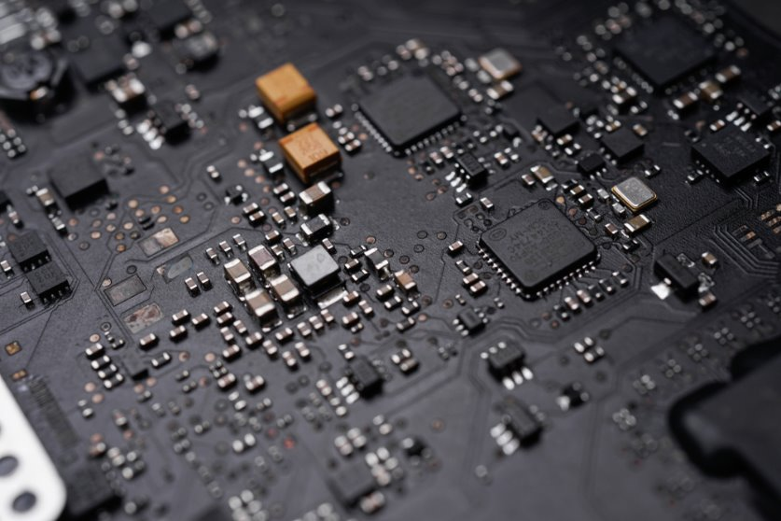
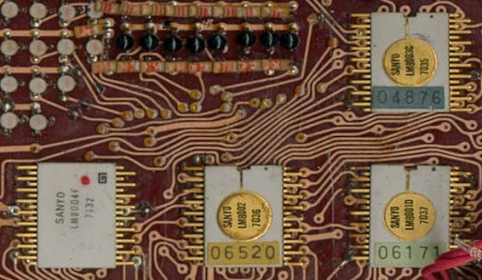
Older pcbs/circuits
modern pcbs

Slide 4
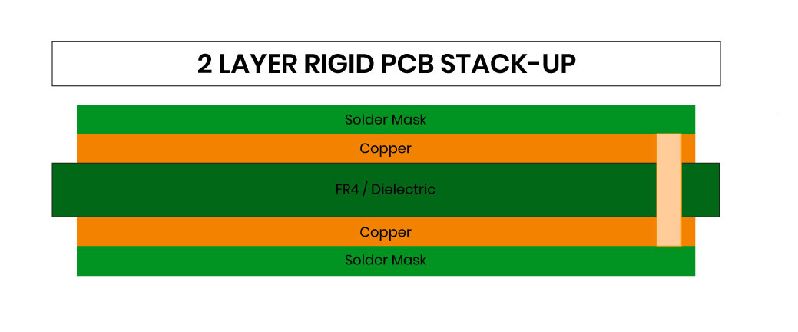
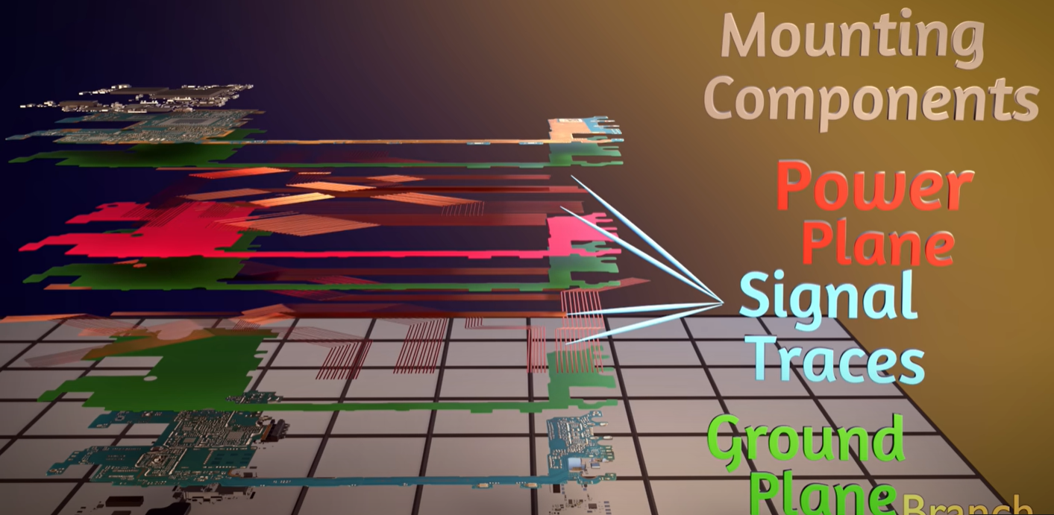
10 conductive layers
PCB layers
Notes:
All PCBs are built from alternating layers of conductive copper with layers of electrically insulating material. Conductive features on printed circuit boards include copper traces, pads, and conductive planes. The mechanical structure is made up of the insulating material laminated between the layers of conductors. The overall structure is plated and covered with a non-conductive solder mask, and silk screen is printed on top of the solder mask to provide a legend for electronic components. After these fabrication steps are completed, the bare board is sent into printed circuit board assembly, where components are soldered to the board and the PCBA can be tested

Slide 5
The process overview
Schematic Design
Layout
Gerber
Assembly and Test
Circuit design
Choosing components
Placing on schematic
DRC check
Board size
Placing components
Routing Traces + polygon planes
DRC check
Order board through manufacturer
Order components
Soldering
Test if works!
DEBUGGING!!!!

Slide 6
The project
Board Design:
Each of you make a new PCB Project File within the PCB Lab Workspace (make sure it's not in the Autonomy Lab workspace!!) and name the project "NAME_HolidayTree" that does the following:
You take in an input of 4.5V (which is going to come from 3-AA batteries from a set of screw terminals), connect the circuit to a 555 timer with a frequency of ~1.4 Hz, and then connect the circuit to a Dual JK Flip Flop which will be used as a 2 bit counter.
The JK FF will be in a configuration so that it'll light up the LEDs in a set order, and there will be two LEDs lit up at any given time, so figure out the configuration of the Q outputs to the LEDs. You can't directly connect the output of the JK FF to the LEDs (why not?), so you'll need to use the two transistors, a PMOS and a NMOS and connect it to the LEDs instead.
There's a common configuration that has a PMOS and an NMOS that is not an amplifier. If you wish to know what this configuration is you can just ask us and we'll let you know. Use this configuration and then connect the output of this circuit to the LEDs.
These LEDs will be three sets of Red, Green, Blue, and Yellow LEDs (for a total of 12 LEDs) with a current rating of 10mA.
Layout:
The shape of the board is a Christmas Holiday tree, with 2 layers
Make sure the longest edge on either side of the board isn't bigger than 3"x3".
Make sure the front side has all of the circuit components and the backside only has LEDs.

Slide 7
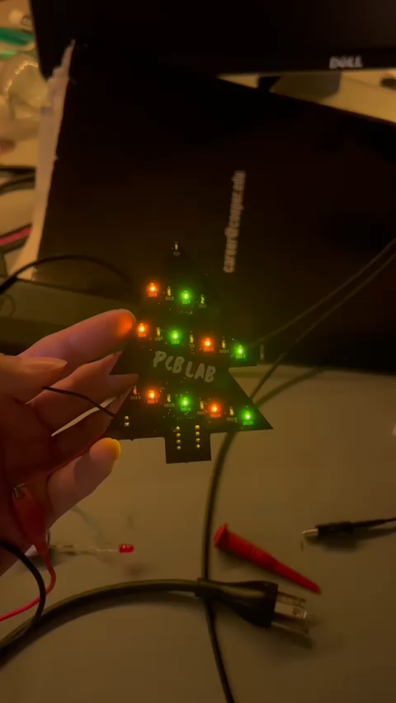
The Project
We will provide the Bill of Materials (BOM). You can choose to deviate from the resistor and capacitor values we had if you want (let us know ahead of time), but make sure to keep the same ICs and connectors we add; don't add anymore or remove any of them
FINISH SCHEMATIC DURING THIS WORKSHOP, WHATEVER YOU DON'T FINISH, HAVE IT DONE BY THE NEXT TIME WE MEET, WHICH IS NEXT MONDAY !!!!!

Slide 8
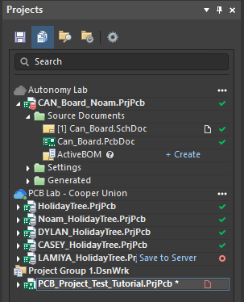
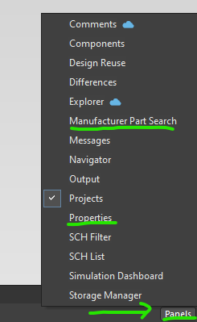
Altium Designer Key binds and panels
Schematic introduction
Right now, we'll be working with Schematic Document (.schdoc) file
Bottom Right has more panels. The important ones are Manufacturer Part Search & Properties
Left Panel is Project Directory.

Slide 9
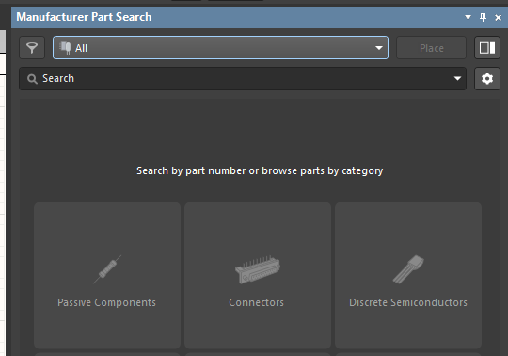
Altium Designer Key binds and panels
Manufacturer Part Search
There's a lot of info here and filters for searching.
Since we already know our Bill of Materials (BOM) we can just type in the Part Number.
Typically to find components you'd have to search here AND Mouser/DigiKey.

Slide 10
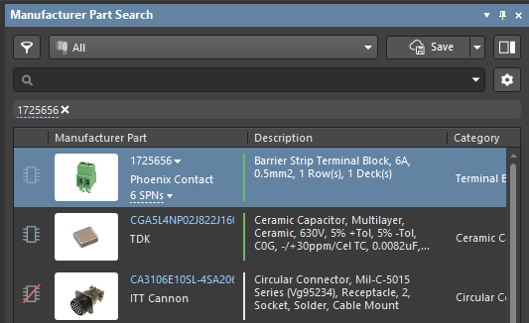
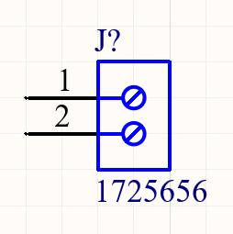
Altium Designer Key binds and panels
Manufacturer Part Search
Has Schematic and Layout Model
Part Lifecycle is Active
Missing Schematic/
Layout Model
Click and drag the component to the schematic to insert it into the design.

Slide 11
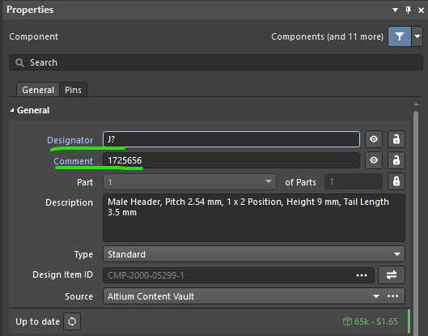
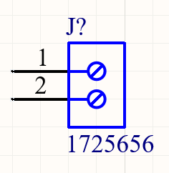
Altium Designer Key binds and panels
Manufacturer Part Search
Reference Designator (RefDes)
Link between schematic & layout
Also easy to call out for reviews
By default, they're given ?
Part Number
Common RefDes:
R – Resistor
L – Inductor
C – Capacitor
F – Fuse
S – Switch
D/DS – LED/Diode​
J – Connectors​
K – Relays​
Q – Transistors​
U – IC
Can edit the RefDes in the Properties tab (J? ==> J1). There's also a cool way to enumerate it at the end.

Slide 12
Altium Designer Key binds and panels
Manufacturer Part Search: The BOM
1725656 (Screw Terminal) x1
FDN5618P (PMOS) x2
PMV20ENR (NMOS) x2
NE555P (555 Timer) x1
CD74HC73M96 (JK FF) x1
ERJ-6ENF2200V (220Ohm) x10
ERJ-6ENF1502V (15kOhm) x1
ERJ-6ENF1001V (1kOhm) x1
ERJ-6ENF1100V (110Ohm) x3
C2012X5R1A336M125AC (33uF) x1
C0805F103K5RACTU (10nF) x1
150080RS75000 (Red LED) x3
150080YS75000 (Yellow LED) x3
150080BS75000 (Blue LED) x3
150080GS75000 (Green LED) x3

Slide 13
Altium Designer Key binds and panels
Schematic drawing: keybinds
Click and drag to move stuff
Can press <space>, "X", or "Y" to rotate, flip horizontally, or flip vertically
Ctrl + W – Draw Wire
Click on item and press <delete> to delete

Slide 14
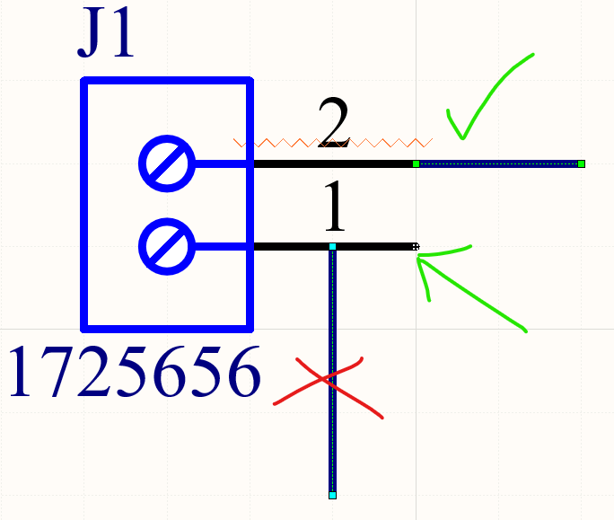
Altium Designer Key binds and panels
Schematic drawing
Need to draw wires from connection ports for a valid connection to occur.

Slide 15
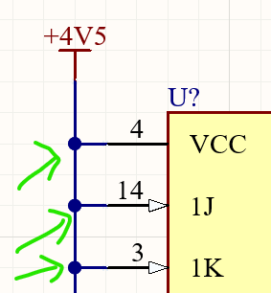
Altium Designer Key binds and panels
Schematic drawing
A connection drawing with a 3-way connection has a junction dot.
AVOID 4-WAY CONNECTIONS!

Slide 16
Altium Designer Key binds and panels
Schematic drawing: wiring
A connection drawing with a 3-way connection has a junction dot.
AVOID 4-WAY CONNECTIONS!

Slide 17
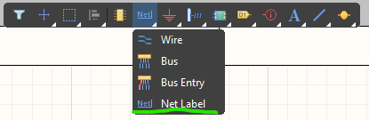
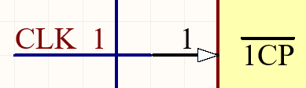
Altium Designer Key binds and panels
Schematic drawing: net labels
The windows on the top have some useful quick access buttons. The net label is useful for naming nets (tunnels in Logisim) so you don't need wires everywhere.
You can edit names in the properties pane.

Slide 18
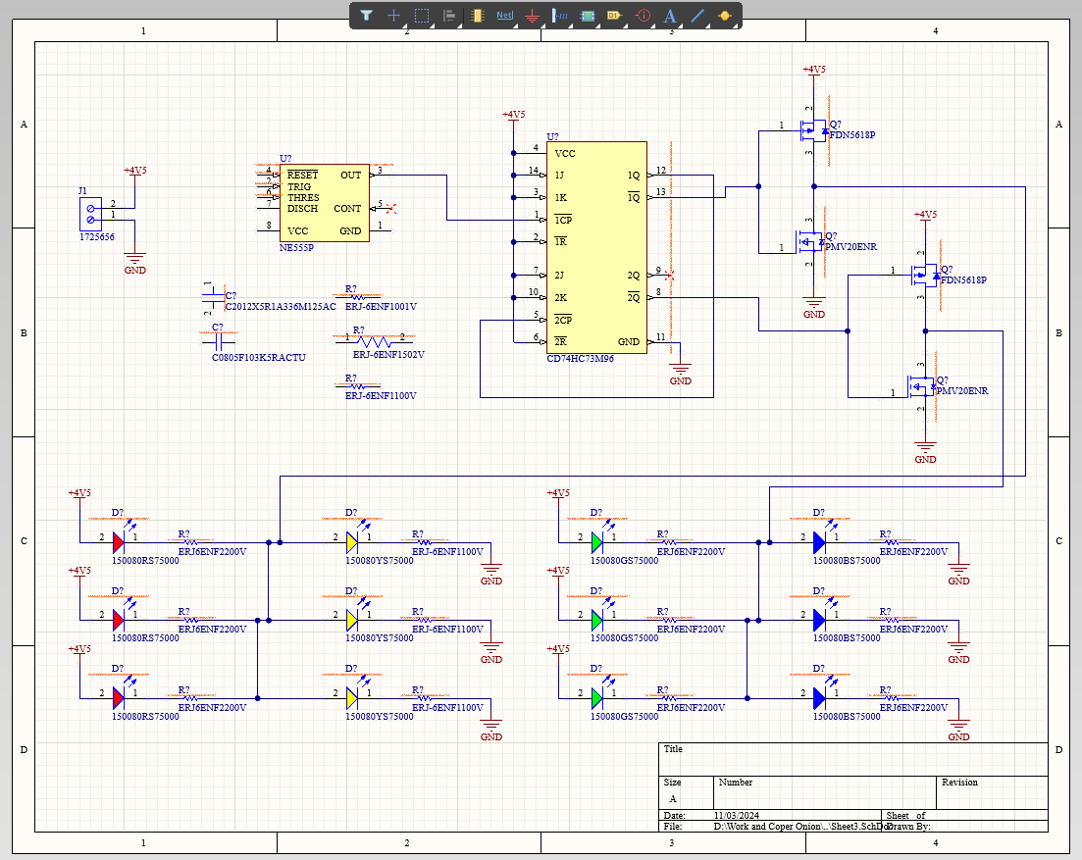
Altium Designer Key binds and panels
Schematic drawing: net labels
You can go from this

Slide 19
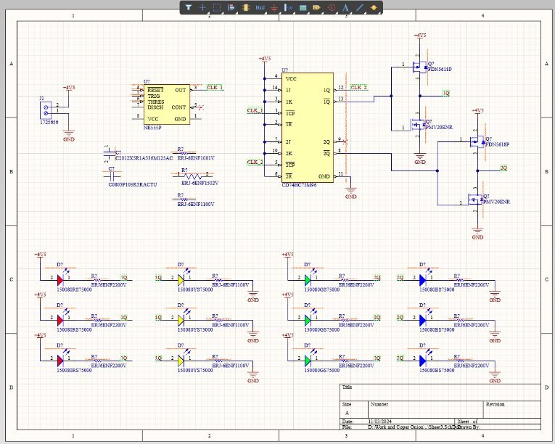
Altium Designer Key binds and panels
Schematic drawing: net labels
==> to this.
You can also name the important/key nets in your design.

Slide 20
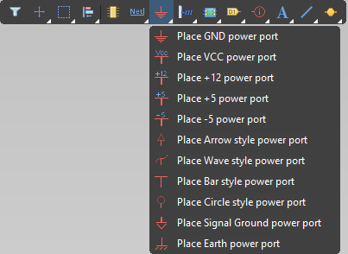
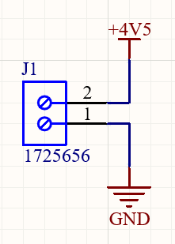
Altium Designer Key binds and panels
Schematic drawing: gnd & pwr ports
The next important thing on top are GND and PWR ports. You can place generic GND and VCC (and rename it to the correct voltage) port as a sort of "special net".

Slide 21
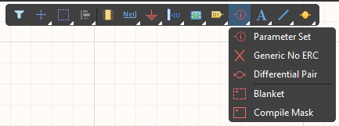
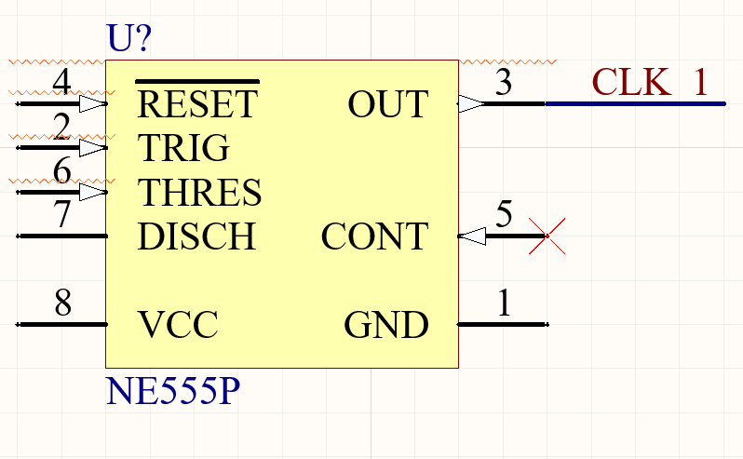
Altium Designer Key binds and panels
Schematic drawing
The next important item on port is the "Generic NO ERC". This means there's no electrical connections, which is great for suppressing some warning and denotes the open connection on your schematic is intentional.

Slide 22
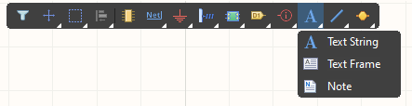
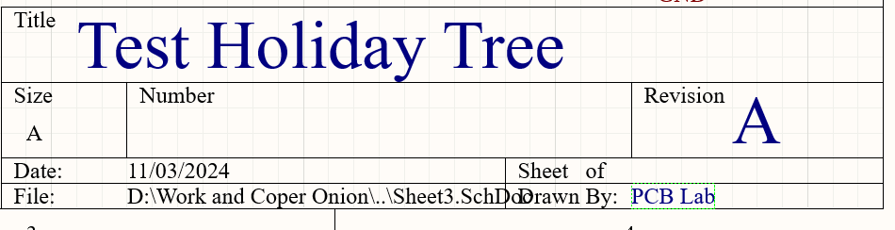
Altium Designer Key binds and panels
Schematic drawing
Next we have text, which is great for comments, and filling out the box at the bottom right.

Slide 23
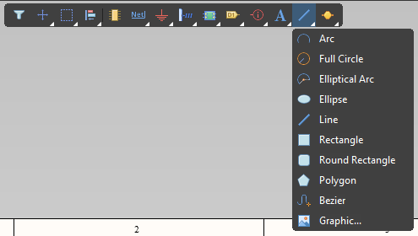
Altium Designer Key binds and panels
Schematic drawing
Finally we have shapes, which can be useful for drawing blocks or inserting a key image (i.e. from a datasheet).

Slide 24
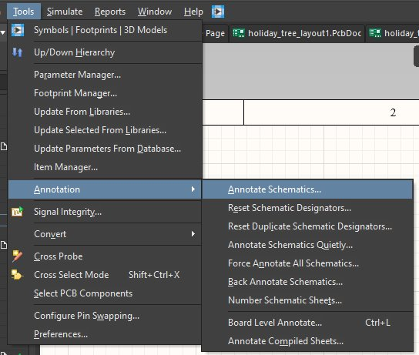
Altium Designer Key binds and panels
Schematic drawing: annotations
Now we'll update the RefDes as promised.
Go to Tools ==> Annotations ==> Annotate Schematics

Slide 25
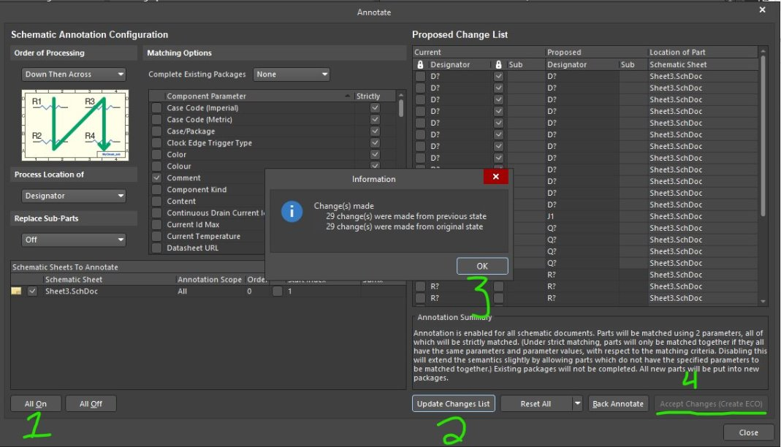
Altium Designer Key binds and panels
Schematic drawing: annotations

Slide 26
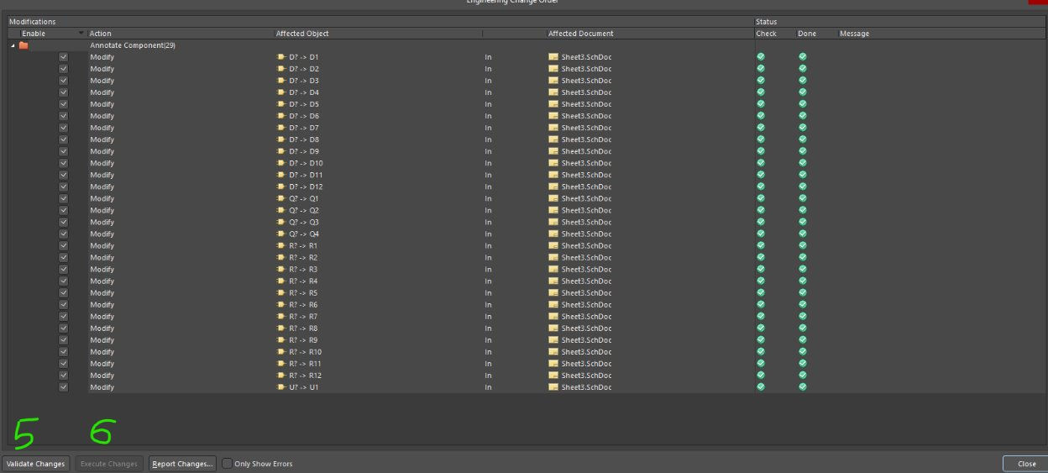
Altium Designer Key binds and panels
Schematic drawing: annotations
Make sure to close all windows bro trying to update the schematic.

Slide 27
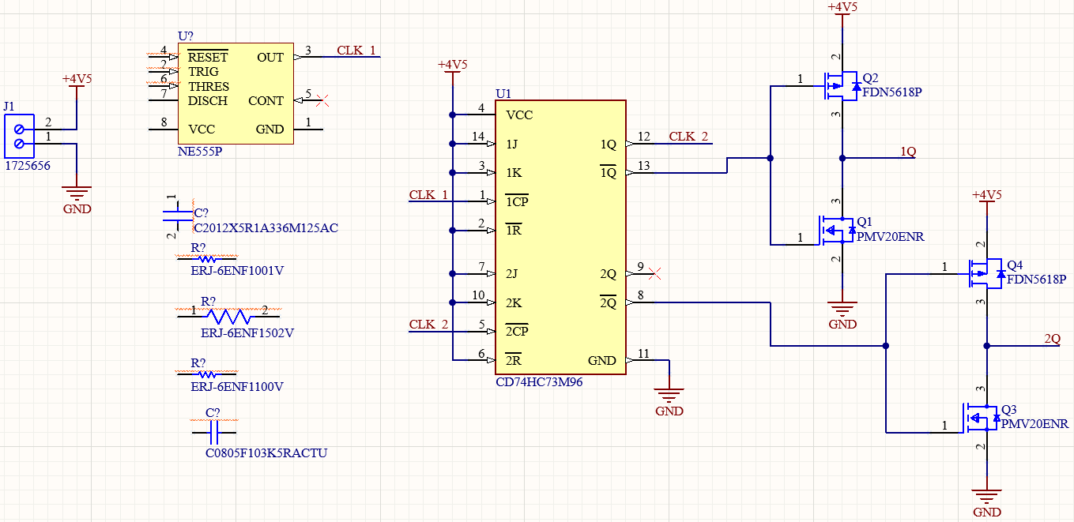
Altium Designer Key binds and panels
Schematic drawing: Final Look

Slide 28
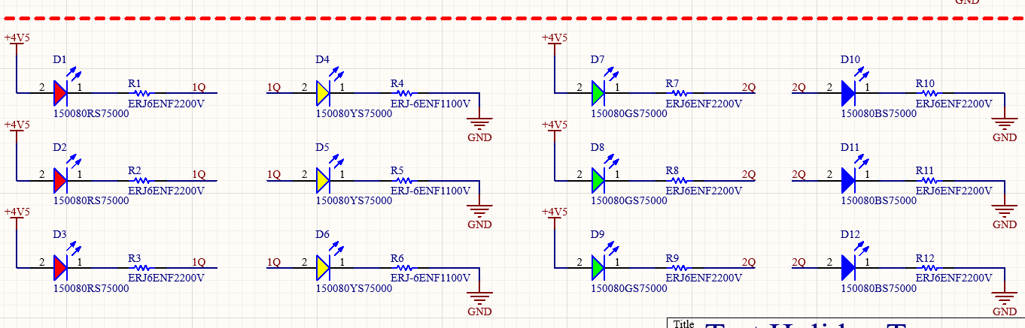
Altium Designer Key binds and panels
Schematic drawing: Final look
Notes:
Technically the most optimal layout is to have the resistors on power plane and diodes on gnd cause of planes (resistors on top plane with PWR, diodes on bottom plane with GND).

Slide 29
Altium Designer Key binds and panels
Schematic drawing: Your Task
Wire up the NE555P (555 Timer) using the leftover components to generate a clock signal approximately at 1.4492Hz (t_H=345.5506mS, t_L=343.035mS):
ERJ-6ENF1001V (1kΩ)
ERJ-6ENF1502V (15kΩ)
ERJ-6ENF1100V (110Ω)
C0805F103K5RACTU (10nF)
C2012X5R1A336M125AC (33uF)
Make sure to refer to the datasheet to get all the connections

Slide 30
PCB LAB Workshop 2: Layout
Azra Rangwala
Ilona Lameka
Ridwan Hussain
Casey ye

Slide 31
The process overview
Schematic Design
Layout
Gerber
Assembly and Test
Circuit design
Choosing components
Placing on schematic
DRC check
Board size
Placing components
Routing Traces + polygon planes
DRC check
Order board through manufacturer
Order components
Soldering
Test if works!
DEBUGGING!!!!

Slide 32
Altium Designer Key binds and panels
layout: Your Task
Making a board shape
How to Place Components
How to draw a wire + via
Working with planes (creating one, shelving it, and repouring it)
Swap between view configurations
Filter which components you can select
Adding text/images (next week)
Going through Design Rule Check (DRC) (next week)

Slide 33
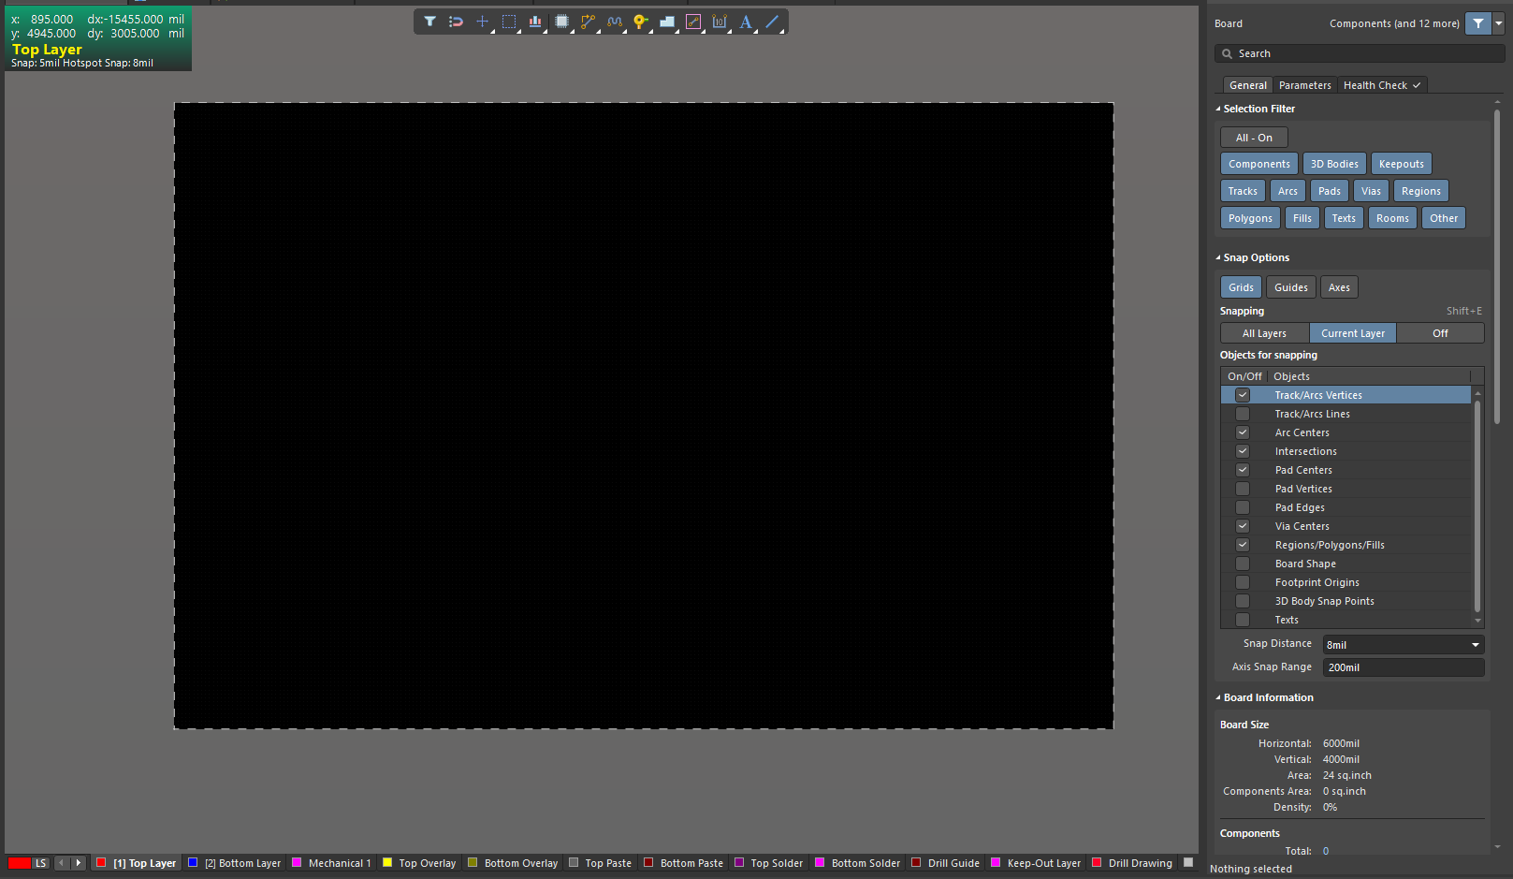
Altium Designer Key binds and panels
layout: Board shape
You should start off with this screen.
First Save the project and make sure to periodically to save.

Slide 34
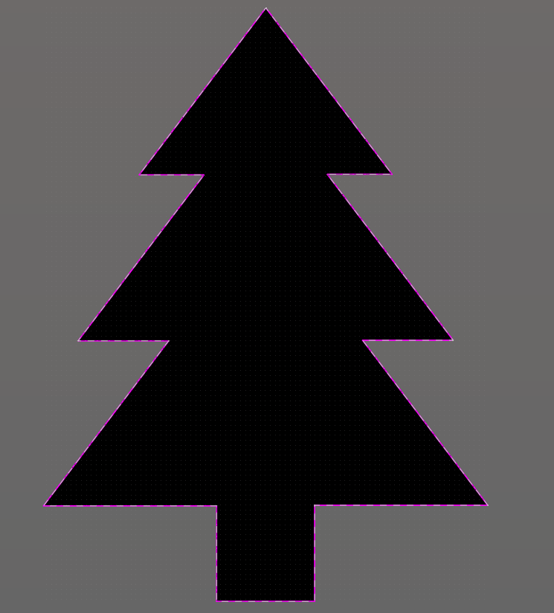
Altium Designer Key binds and panels
layout: Board shape
First thing is board shape. The goal is to make a Christmas tree.

Slide 35
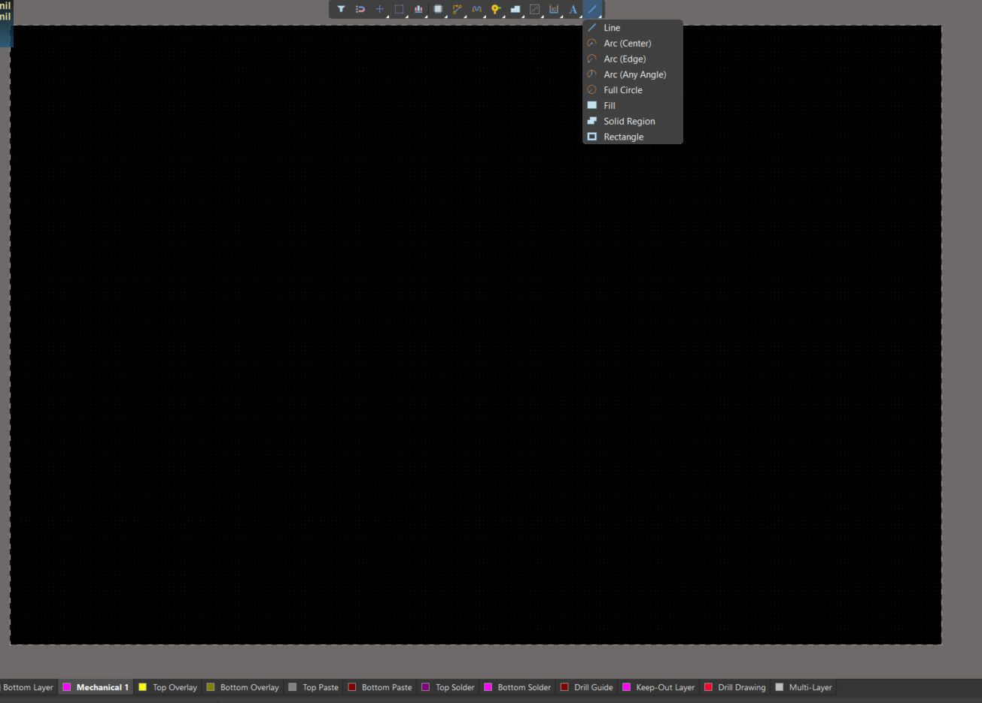



Altium Designer Key binds and panels
layout: Board shape
We'll be using the Line ON the Keepout layer

Slide 36

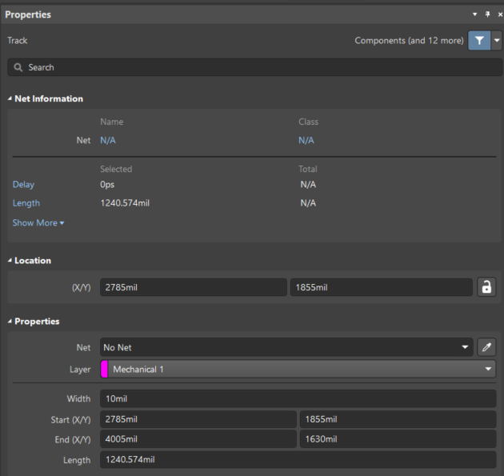
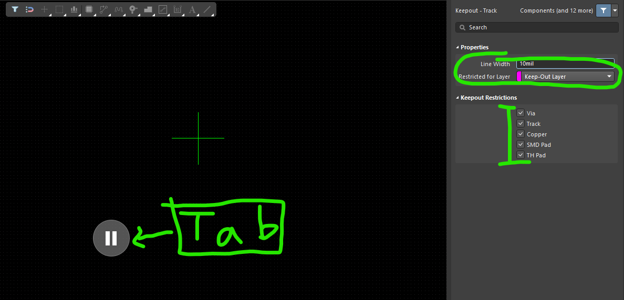
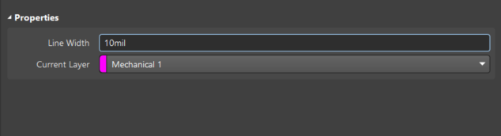

Altium Designer Key binds and panels
layout: Board shape
On the properties panel to the right, we'll make sure we're on the Mechanical 1 Layer
Note: Press "Tab" to stop Altium from scrolling

Slide 37
Altium Designer Key binds and panels
layout: Board shape
Now we'll draw a tree. You can design the tree yourself (make sure it's within a 3"x3" size!) or follow the line coordinates below:
Start (X/Y) | End (X/Y)
2075mil, 1115mil | 2567.565mil, 1115mil
2075mil, 1115mil | 2075mil, 1595mil
1205mil, 1595mil | 2075mil, 1595mil
1205mil, 1595mil | 1834mil, 2424.655mil
1376.948mil, 2425mil | 1834mil, 2425mil
1376.948mil, 2425mil | 2010mil, 3260mil
1686.209mil, 3260mil | 2010mil, 3260mil
1686.209mil, 3260mil | 2322.174mil, 4098.841mil
Start (X/Y) | End (X/Y)
2322.174mil, 4098.841mil | 2955.764mil, 3263.132mil
2632.565mil, 3263.132mil | 2955.764mil, 3263.132mil
2632.565mil, 3263.132mil | 3265.617mil, 2428.132mil
2808.565mil, 2428.132mil | 3265.617mil, 2428.132mil
2808.565mil, 2428.132mil | 3437.827mil, 1598.132mil
2567.565mil, 1598.132mil | 3437.827mil. 1598.132mil
2567.565mil, 1115mil | 2567.565mil, 1598.132mil

Slide 38
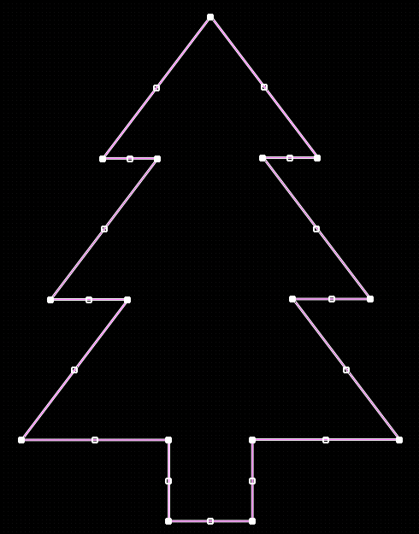
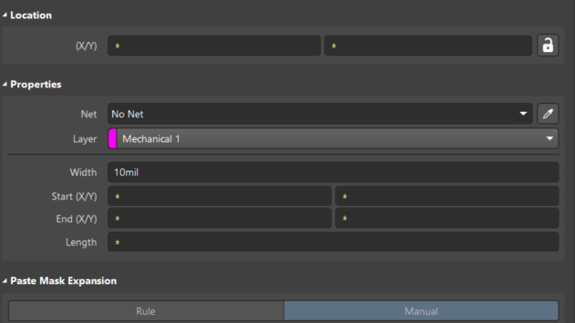


Altium Designer Key binds and panels
layout: Board shape
Next Highlight the entire tree by pressing Tab, and press the lock button

Slide 39
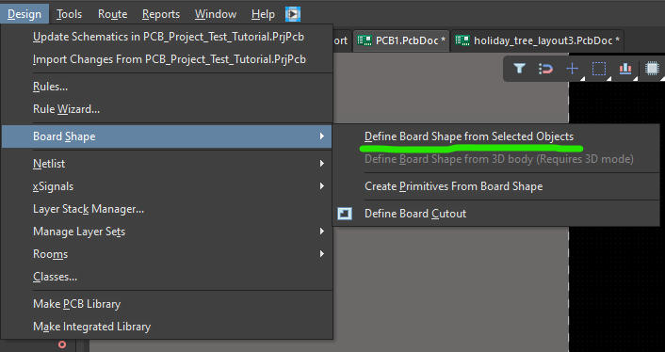
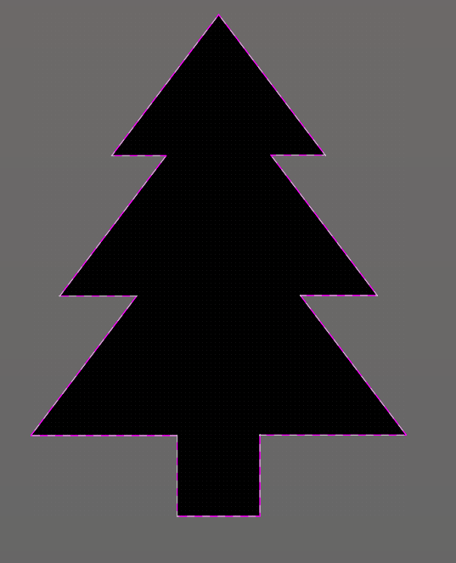
Altium Designer Key binds and panels
layout: Board shape
Finally, while the lines are highlighted, press Design --> Board Shape --> Define Board Shape from Selected Objects

Slide 40
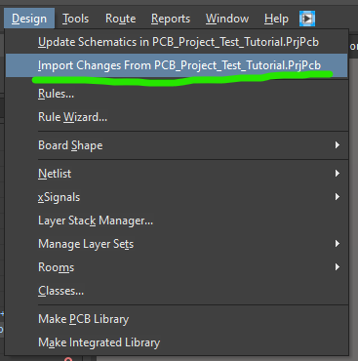
Altium Designer Key binds and panels
layout: Component Placement
Next we're going to place some components.
Design --> Import Changes

Slide 41
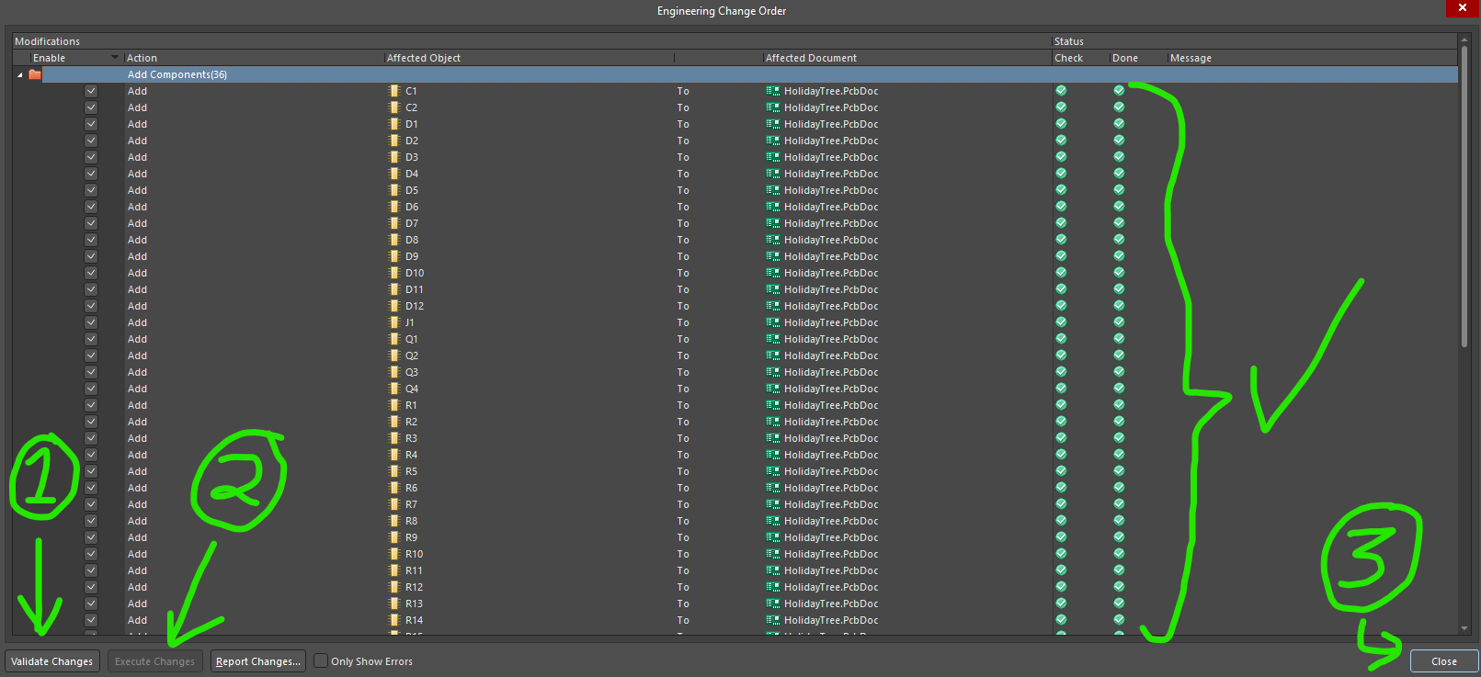
Altium Designer Key binds and panels
layout: Component Placement
You can place all the components, but in general it's better to place components based on the blocks

Slide 42
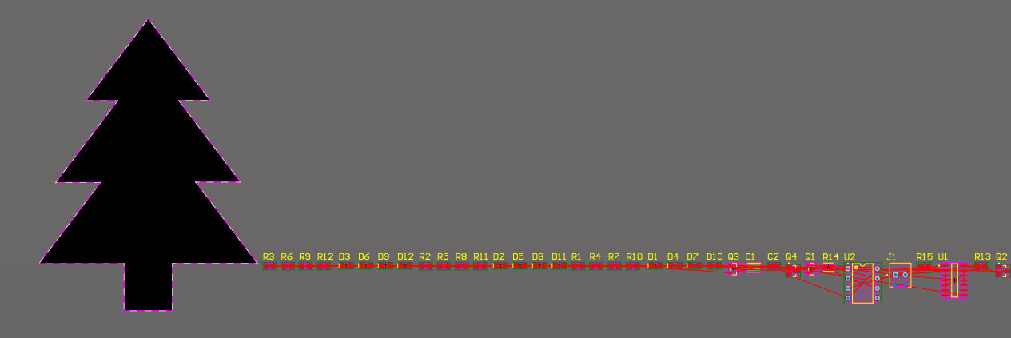
Altium Designer Key binds and panels
layout: Component Placement
If you placed all the components you'll get something like this.

Slide 43
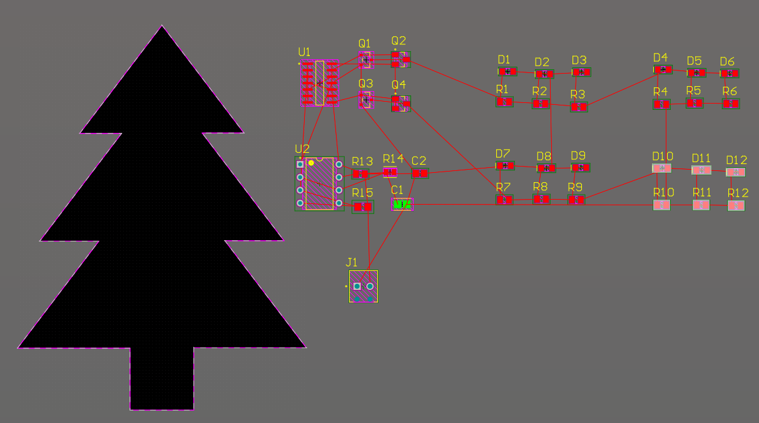
Altium Designer Key binds and panels
layout: Component Placement
It really helps to organize the components first
Split screen is great to view layout and schematic at the same time
JK FF
Yellow
Red
555 Timer
Green
Blue
Connector

Slide 44
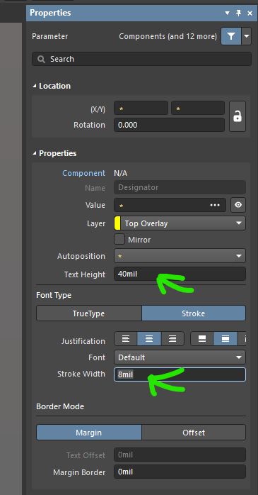
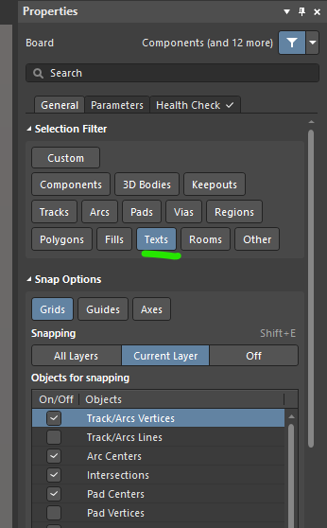
Altium Designer Key binds and panels
layout: Component Placement
Now we're gonna decrease the text size a little to make our lives a little easier
Ctrl + A
Text Height: 40mil
Stroke Width: 8mil

Slide 45
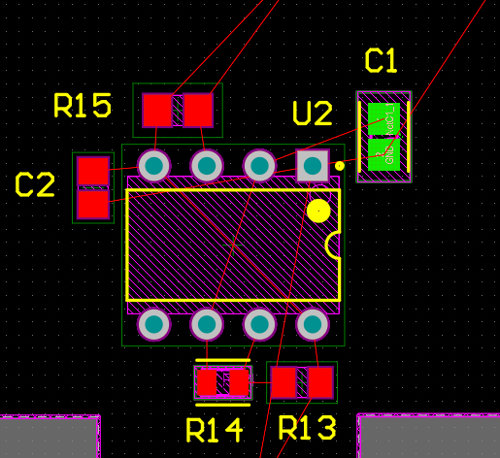
Altium Designer Key binds and panels
layout: Component Placement
Here's a sample of one of the good ways to lay out the 555 timer (you don't need to copy it). The rest lines are nets we need to draw in.

Slide 46


Altium Designer Key binds and panels
layout: Routing
To draw a wire, press Ctrl + W

Slide 47

Altium Designer Key binds and panels
layout: Routing
For the rest of the routes, they're all the Power Net (+4V5) and Ground Net (GND)
For those connections, we can add a copper pour, or a plane that connects all of those nets together.

Slide 48


Altium Designer Key binds and panels
layout: planes
Tools --> Polygon Pours --> Polygon Manager
New Polygon from... --> Board Outline

Slide 49


Altium Designer Key binds and panels
layout: planes
Choose a net and layer, and then press OK.
For this board, +4V5 on top and GND for bottom is best

Slide 50



Altium Designer Key binds and panels
layout: planes

Slide 51


Altium Designer Key binds and panels
layout: planes
Routing now kind of becomes difficult with the polygon.
Good thing we can hide it (shelve it)
We can then bring it back out for later (repour).
Be careful to not cut off a polygon pour!

Slide 52

Altium Designer Key binds and panels
layout: Bottom Side
Sometimes it's hard to see things, especially if we have things on the top and bottom layer. (LEDs go on bottom, rest go on top!)
To put components on the bottom side, when you select the component you can choose which layer it goes on.

Slide 53

Altium Designer Key binds and panels
layout: bottom side
To route on the bottom layer, when you start the route you can select bottom layer
To change between top and bottom layer you need a via. You can draw one with "Ctrl" "Shift" "Scroll Up" while routing to insert a via mid-route.
"Ctrl" & "Shift" & "Scroll Up"

Slide 54
Altium Designer Key binds and panels
layout: bottom side
Note the default via size on Altium is rather large. It'd be ok to have a via sized
Diameter 20mil
Hole Size 10 mil
"Ctrl" & "Shift" & "Scroll Up"

Slide 55


Altium Designer Key binds and panels
layout: Viewing
As things become more hectic and especially for more complicated designs, we can start to filter out the things we can and can't see.
Panels --> View Configuration

Slide 56

Altium Designer Key binds and panels
layout: Viewing
We can filter things to view things only on the top layer (left set of arrows), or to view only the things on the bottom layer.
We can also choose what we see in each layer.
Bottom
Top

Slide 57


Top Side: components
Bottom Side: LEDs

Slide 58
PCB LAB Workshop 3: Review + Gerber out
Azra Rangwala
Ilona Lameka
Ridwan Hussain
Casey ye

Slide 59
The process overview
Schematic Design
Layout
Gerber
Assembly and Test
Circuit design
Choosing components
Placing on schematic
DRC check
Board size
Placing components
Routing Traces + polygon planes
DRC check
Order board through manufacturer
Order components
Soldering
Test if works!
DEBUGGING!!!!

Slide 60
Altium Designer Gerbering out
Adding text/images to your board
Run Design Rule Check (DRC)
Adjust your Rules
Export your mom
Export your CAM files

Slide 61


Altium Designer Key binds and panels
layout: Adding Text
To place text press the "A" button on the top pane.
All text and images belong on the Overlay Layer. If you have text on the Top Layer, then that is a route, not text!
You can default this by having the "Top Overlay" being selected at the bottom.
Typically you'd add the board name (Holiday Tree).
You can also call out different blocks (transistor inverter), or have fun text like "My first PCB!"
Make sure to add your name as well!
Note: If you want text on the edge, the lines are angled at 53º.

Slide 62

Altium Designer Key binds and panels
layout: Adding Text

Slide 63

Altium Designer Key binds and panels
layout: Adding Text
Make sure to add text on the screw terminals to denote which input is positive and which input is negative.

Slide 64

Altium Designer Key binds and panels
layout: Adding An image
MAKE SURE TO SAVE YOUR BOARD BEFORE PLACING ANY IMAGES!
Edit your photos before placing them (i.e. crop), it is difficult to edit the images once they have been placed!
To place an image Text press Place --> Graphics
Next draw a rectangular size for your image.
The final image has the same width, and scales the height as needed.
Note: Choose an empty area on your board for best results (so few traces or RefDes').

Slide 65

Altium Designer Key binds and panels
layout: Adding An image
The supported file types are .jpg, .png, .bmp, and .svg.
Altium should automatically correct the file type if you choose a different file type (i.e .heic) .
If you have issues, I've found *.jpg is usually what works best for me.
You can invert the image to see if the image looks better.
Keep Union on
The default DPI is usually fine, I wouldn't increase it too much since it might cause Altium to lag.
This make take a second for Altium to load, so be patient. If it takes more than 5 minutes than the file size is likely too large.
You can hit Ctrl + Alt + Delete to open up task manager, kill the Altium process and start it up again (this is why you need to save!)
The file size should NOT be bigger than 1MB.

Slide 66

Altium Designer Key binds and panels
layout: Adding An image

Slide 67
Altium Designer Key binds and panels
layout: Design Rule Check
Now we are going to run the Design Rule Check, or DRC. This is usually the last step for a board where the program has a static checker on
Tolerances (the minimum sizes or distance between things)
If everything from the schematic has been routed
If everything from the schematic has been routed correctly
It is NOT able to simulate your board or anything fancy like that, it's simply a static checker.

Slide 68


Altium Designer Key binds and panels
layout: Design Rule Check
Go to Tools --> Design Rule Check
Hit "Run Design Rule Check..." at the bottom left

Slide 69


Altium Designer Key binds and panels
layout: Design Rule Check
If everything is ok, you should be seeing something like this.
If you see more errors, fix them first!

Slide 70



Altium Designer Key binds and panels
layout: Design Rule Check
The first list is the different rules that are checked, the following lists are where that violation occurred.
You can click on the error to jump to where it occurred in the PCB.

Slide 71


Altium Designer Key binds and panels
layout: Design Rule Check
For the 15 errors we got, we'll be going through them and waiving them one by one.
IF YOU GET ANY OTHER ERROR, FIX THOSE FIRST BEFORE MOVING ON!
Go to Design --> Rules
Type in the keyword for each error and scroll through the list.
For this first error, the keyword is "clearance"

Slide 72

Altium Designer Key binds and panels
layout: Design Rule Check
If we read the error clearly, it says "Clearance Constraint: (5.907mil < 10mil) Between Pad C1-1(2615mil,2159.018mil) on Top Layer And Pad C1-2 (2615mil, 2090.982mil) on Top Layer".
This means the distance between the two pads are too small, so we'll be changing that.
You can change the distance on "1" or "2" in the image to the right to 5.9mil.
Hit "OK" at the bottom right when you're done.

Slide 73

Altium Designer Key binds and panels
layout: Design Rule Check
If you run the DRC again, you should only see 14 errors, and the Clearance Constraint error is gone.

Slide 74
Altium Designer Key binds and panels
layout: Design Rule Check
NOTE: IN GENERAL YOU CAN'T SIMPLY WAIVE THE ERRORS ONE BY ONE!
What you'd do instead is notice there's an error, and go to the manufacturer's PCB capabilities page and see if that error is an issue or not for the PCB technology you plan on using (i.e. simple/basic or maybe something more advanced).
We've checked this before so we know it's ok to waive these errors.

Slide 75
Altium Designer Key binds and panels
layout: Design Rule Check
For example, since we're ordering the boards from JLC PCB, we'd go to JLCPCB PCB Capabilities, and look for the error we're interested in, i.e. SMD pad to pad clearance.
0.15mm is exactly 5.9 mills, so barely safe! The rest of the tolerances are a lot more lenient, and JLC makes sure to run a flying probe test to make sure there are no accidental shorts in our circuit after the PCB has been manufactu​red.
Go through all the errors and waive them one by one.

Slide 76
Altium Designer GERBING OUT
Gerber Out: Overview
This process is for gerbering out from Altium Designer to JLCPCB:
We are generating the files needed by PCB manufacturers to create our board correctly.
Each PCB tools has a different method to generate the different files for EACH PCB Manufacturer.
The best way to make sure you get it correct is to follow the manufacturer's page on how they want the file
Note: This was the link for the JLCPCB board manufacturer from Altium Designer: https://jlcpcb.com/help/article/How-to-export-Altium-PCB-to-gerber-files

Slide 77

Altium Designer GERBING OUT
Gerber Out: Cam files
File --> Fabrication Outputs --> Gerber Files (file with all the routes, connections, and board size)
Make sure Left Side says: Units --> inches, Decimal --> 0.01mil, Outputs --> filename.*, Others --> only top one is checked "(include unconnected mid-layer pad")
We will be checking the boxes with the following filetypes (look at screenshot to double check):
.GTL, .GBL, .GTO, .GBO, .GTS, .GBS, .GM1, .GKO
For multi-layered boards, in general you want all Copper Layers, all Silkscreen (only two), all solder mask (only two), all mechanical layers (usually 1), and Keep-Out Layer.

Slide 78

Altium Designer GERBING OUT
Gerber Out: Cam files

Slide 79

Altium Designer GERBING OUT
Gerber Out: Cam files
Next go to advanced tab and check:
plus & minus aperture tolerance is 0.005mil
leading/trailing zeros has "suppressing leading zeros"
plotter type has "unsorted (raster)"
others has "optimize change location commands", "use software arcs", and "generate DRC rules export file (.RUL)" all checked (look at screenshot to double check)
Afterwards, hit "Apply" at the bottom right to view your generate gerber. Make sure all the traces, planes look visually ok (bottom layer will be on top), and the mechanical layer is visible.
Hit Ctrl + S to save (use the default file name or "GerberFiles.cam")

Slide 80

Altium Designer GERBING OUT
Gerber Out: Cam files

Slide 81


Altium Designer GERBING OUT
Gerber Out: NC Drill Files
File --> Fabrication Outputs --> NC Drill Files (file with the different holes, like vias for drilling)
Units: Inches, Format: 2:4
Suppress Leading Zeros, Reference to relative origin
check Optimize change locations commands (look at screenshot to double check)
If you get a pop-up that says import drill data, just hit "OK"
Make sure the vias look ok & hit Ctrl + S
Use default name or "NC_Drills.Cam"

Slide 82

Altium Designer GERBING OUT
Gerber Out: NC Drill Files

Slide 83


Altium Designer GERBING OUT
Gerber Out: Zip 'Em Up
To zip the file, right click the PrjPcb (top of the file tree) and click on "Explore"
Right click the outputs and convert it to a zip file (technically you're supposed to filter out the files, but JLC doesn't mind and it makes our lives easier)
Note the Path for the file and jot it down somewhere or save the zip file in an easier folder desktop/downloads/documents folder

Slide 84


Altium Designer GERBING OUT
Gerber Out: Zip 'Em Up
Upload the file to JLC PCB when ordering, make sure it looks ok and then order away! (link here)
Note: As a check, you can use the Gerber Viewer tool (you need to login for this) and make sure the dimensions of your board looks correct.
The Gerber files are the extensions from before, and the NC drills are the .DRR file.

Slide 85

Altium Designer GERBING OUT
Gerber Out: Zip 'Em Up

Slide 86
Altium Designer GERBING OUT
Gerber Out: Ordering from JLC
Green is the best for shipping times, you can choose a goofier color if you don't mind longer wait times.
Other manufacturers, such as PCBWay, can have more color options but JLC is usually the cheapest and fastest.
If you want the cheapest option, go with "Surface Finish HASL". My recommendation is to go with "LeadFree HASL" (still really cheap)
This is the option we'll be using for your boards
If you want gold pads on your board, can you do "ENIG" which also makes for high quality boards, but that's too expensive for this board.
Make sure the "Remove Mark" option is selected for the Mark on PCB

Slide 87
Altium Designer GERBING OUT
Gerber Out: Closing remarks
You guys WON'T be ordering the boards, we'll be ordering it in the PCBLab account, just wanted you guys to go through the entire process up until payment since that's where the engineering stops.
Make sure to give the $20 CASH to Ridwan (or any of the operators) for this to occur
Also send an email to PCBLab with the Subject: "FIRSTNAME LASTNAME Holiday Tree File" with your entire project zip file. This would also be the best place if you want any specific options (i.e. a different colored board).
You'll be receiving the PCBs in January/February where we'll host a final workshop (or two) on assembling and testing/debugging the boards.
Click here to fill out a Microsoft Forms to leave feedback on how the event went and what improvements you think we can make so the event goes smoother if it runs again.

Slide 88
Thanks for joining the PCB Lab workshop.

Slide 89
PCB LAb Operator Final Zip checklist
Make sure the schematic is 100% correct
Run the DRC
Check to see if all the GND and +4V5 nets are connected using the PCB Filter
Make sure all none of these routes are being "choked off" too much because of routing too close to the edge.
Make sure all the silk screen are on the board, nothing is on the actual board outline
Check for their name on the board
Check to see if the Gerber File and NC Cam file look fine compared to the board they have
When on the JLC website, make sure everything looks normal
Pray it works when the boards when they arrive

